Slide 1
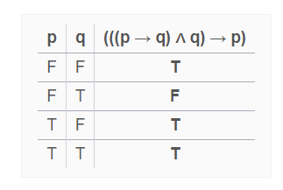
Fallacies
p | q | p → q
T | T | T
T | F | F
F | T | T
F | F | T
Arguments are based on tautologies.
Fallacies are based on contingencies.
The proposition ((p → q) ∧q) → p is not a tautology, because it is false when p is false and q is true.
This type of incorrect reasoning is called the fallacy of affirming the conclusion.
Example:
If you do every problem in this book, then you will learn discrete mathematics.
P = You do every problem in this book.
Q = You learn discrete mathematics.
You learned discrete mathematics. Therefore, you did every problem in this book. You can not conclude this because for q true p may be False or true.

Slide 2
Fallacy of denying the hypothesis.
p | q | p → q
T | T | T
T | F | F
F | T | T
F | F | T
The proposition ((p → q)∧￢p)→￢q is not a tautology, because it is false when p is false and q is true.
Is it correct to assume that you did not learn discrete mathematics if you did not do every problem in the book, assuming that if you do every problem in this book, then you will learn discrete mathematics?
It is possible that you learned discrete mathematics even if you did not do every problem in this book. This incorrect argument is of the form p → q and ￢p imply ￢q, which is an example of the fallacy of denying the hypothesis.

Slide 3
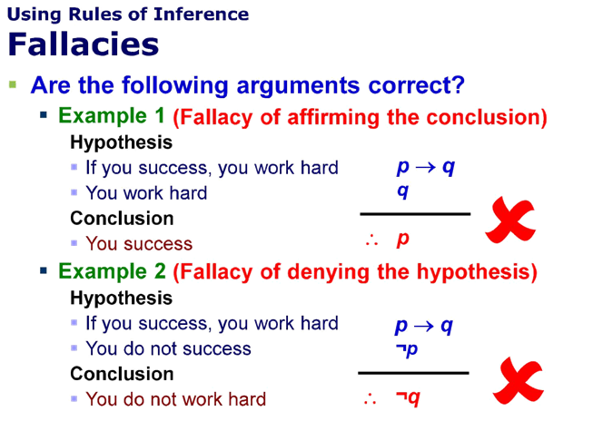
p | q | p → q
T | T | T
T | F | F
F | T | T
F | F | T
p | q | p → q
T | T | T
T | F | F
F | T | T
F | F | T

Slide 6
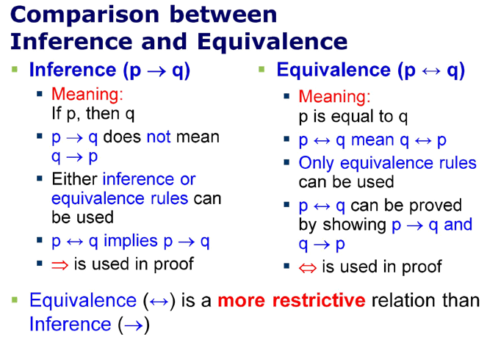

Slide 7
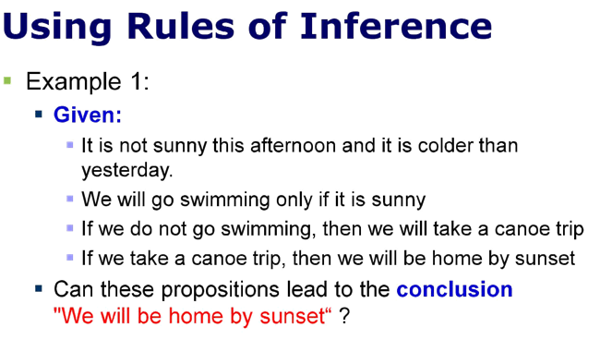

Slide 8
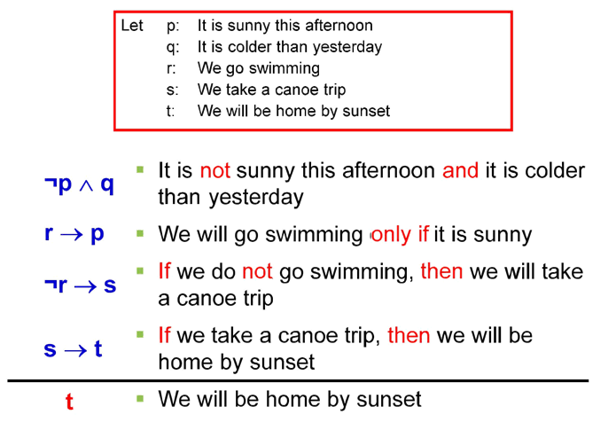
(¬(p∧q)∧(r→p)∧(¬r→s)∧(s→t))→t would be a tautology

Slide 9
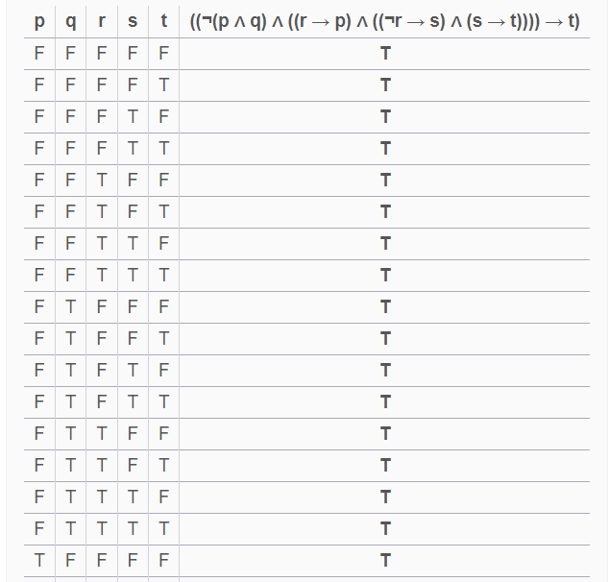

Slide 10
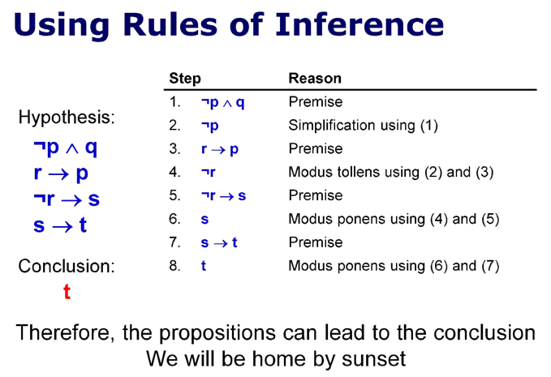

Slide 11
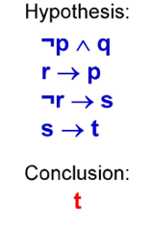
You can also apply laws of logic for inveference
Step | Reason
-p∧q | Premise
-p | Simplification using (1)
r → p ≡ -r V p | Premise
-r
-r → s ≡ r V s | Premise
s
S → t | Premise
T | Conclusion

Slide 12
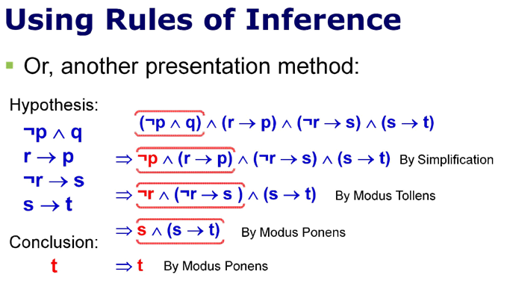

Slide 13
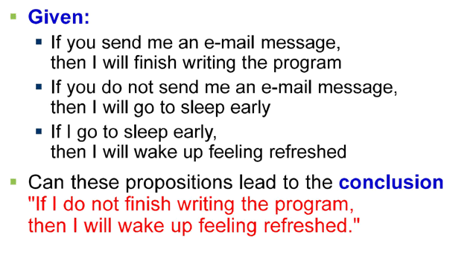
EXAMPLE #2

Slide 14
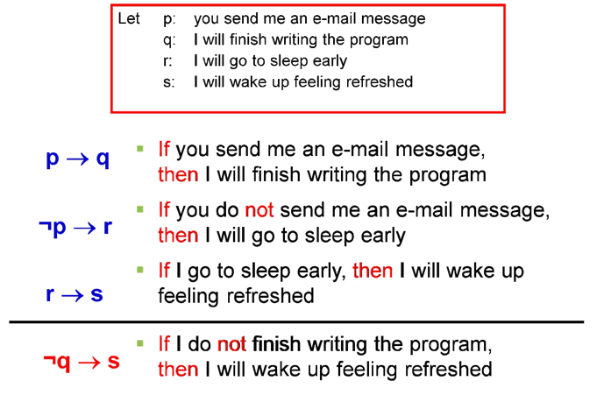
((p->q)∧(¬p->r)∧(r->s))->(¬q->s) is a taughtalogy

Slide 15
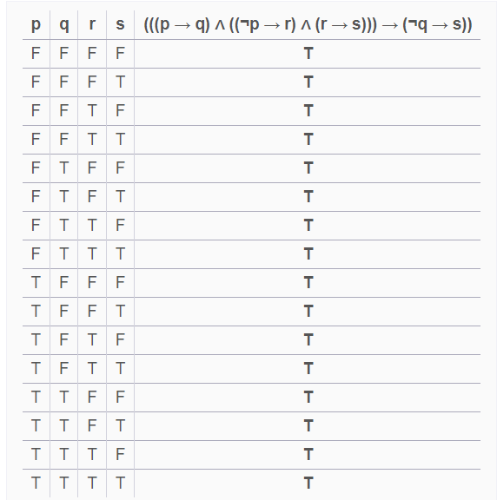

Slide 16
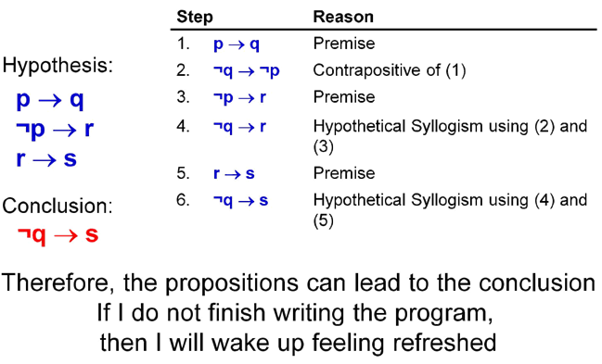

Slide 17
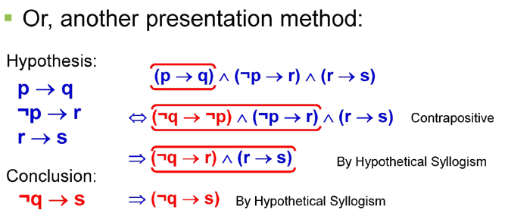

Slide 18
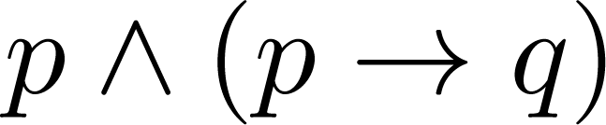
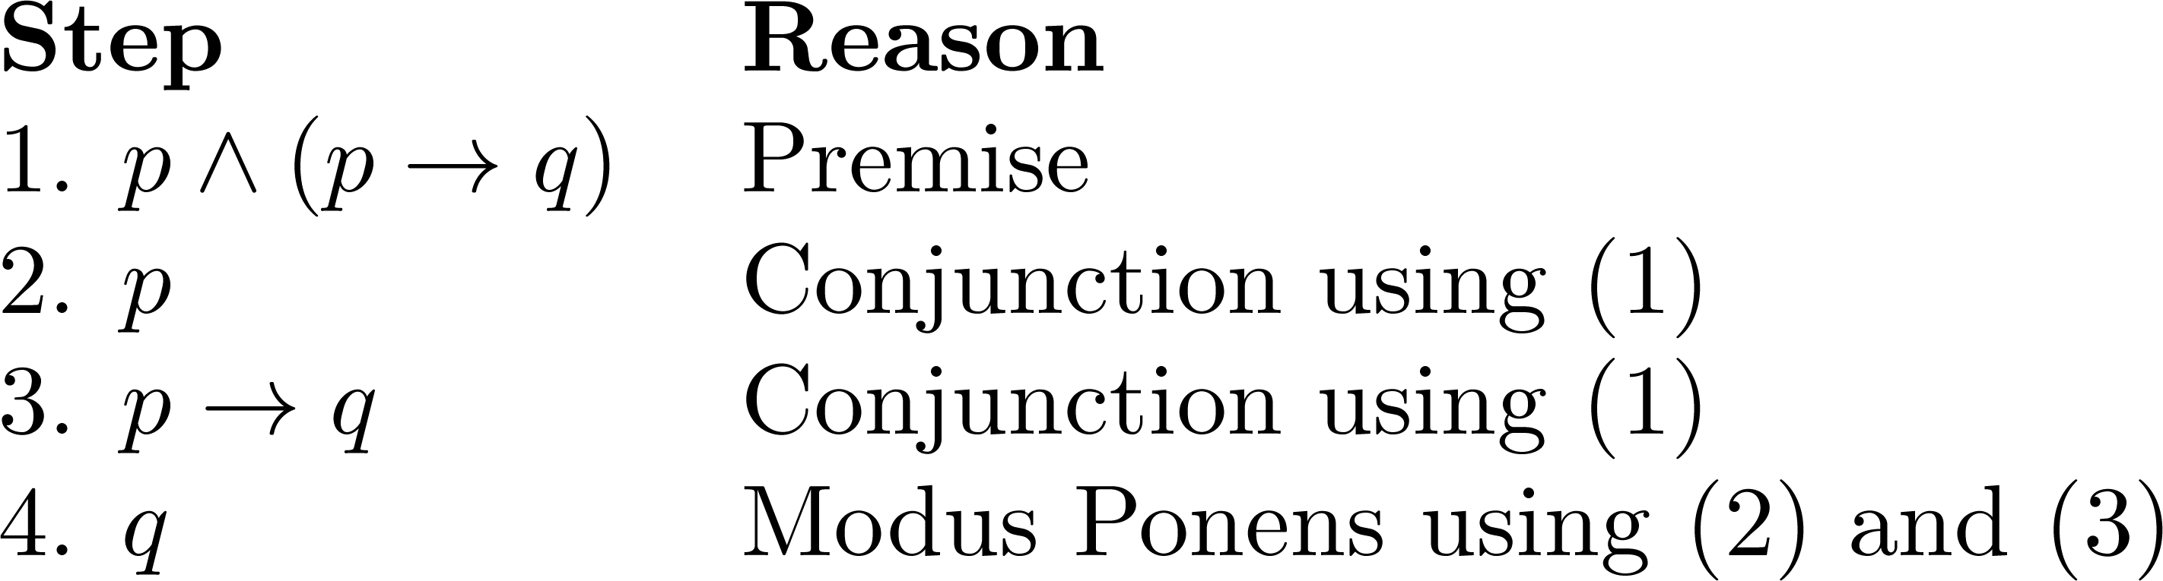
Valid Arguments
Example 3: From the single proposition
Show that q is a conclusion.
Solution:

Slide 19
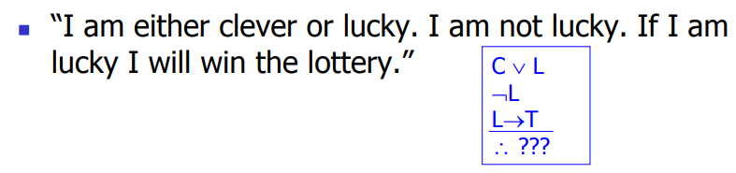
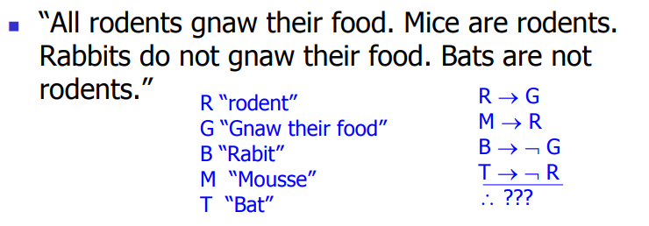
What can be concluded from:

Slide 20
Basic Structures: Sets and Functions
Chapter 2

Slide 21
Sets
Section 2.1

Slide 22
Section Summary
Definition of sets
Describing Sets
Roster Method
Set-Builder Notation
Some Important Sets in Mathematics
Empty Set and Universal Set
Subsets and Set Equality
Cardinality of Sets
Tuples
Cartesian Product

Slide 23
Introduction
Sets are one of the basic building blocks for the types of objects considered in discrete mathematics.
Important for counting.
Programming languages have set operations.
Set theory is an important branch of mathematics.
Many different systems of axioms have been used to develop set theory.
Here we are not concerned with a formal set of axioms for set theory. Instead, we will use what is called naïve set theory.

Slide 24
Sets
A set is an unordered collection of objects.
the students in this class
the chairs in this room
The objects in a set are called the elements, or members of the set. A set is said to contain its elements.
The notation a ∈ A denotes that a is an element of the set A.
If a is not a member of A, write a ∉ A

Slide 25
Describing a Set: Roster Method
S = {a,b,c,d}
Order not important
S = {a,b,c,d} = {b,c,a,d}
Each distinct object is either a member or not; listing more than once does not change the set.
S = {a,b,c,d} = {a,b,c,b,c,d}
Elipses (…) may be used to describe a set without listing all of the members when the pattern is clear.
S = {a,b,c,d, ……,z }

Slide 26
Roster Method
Set of all vowels in the English alphabet:
V = {a,e,i,o,u}
Set of all odd positive integers less than 10:
O = {1,3,5,7,9}
Set of all positive integers less than 100:
S = {1,2,3,……..,99}
Set of all integers less than 0:
S = {…., -3,-2,-1}

Slide 27
Some Important Sets
N = natural numbers = {0,1,2,3….}
Z = integers = {…,-3,-2,-1,0,1,2,3,…}
Z⁺ = positive integers = {1,2,3,…..}
R = set of real numbers
R⁺ = set of positive real numbers
C = set of complex numbers.
Q = set of rational numbers

Slide 28
Set-Builder Notation
Specify the property or properties that all members must satisfy:
S = {x | x is a positive integer less than 100}
O = {x | x is an odd positive integer less than 10}
O = {x ∈ Z⁺ | x is odd and x < 10}
A predicate may be used:
S = {x | P(x)}
Example: S = {x | Prime(x)}
Positive rational numbers:
Q⁺ = {x ∈ R | x = p/q, for some positive integers p,q}

Slide 29
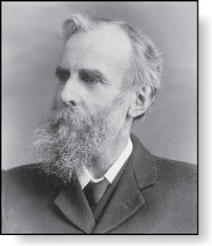
Universal Set and Empty Set
The universal set U is the set containing everything currently under consideration.
Sometimes implicit
Sometimes explicitly stated.
Contents depend on the context.
The empty set is the set with no
elements. Symbolized ∅, but
{} also used.
Venn Diagram
U
a e i
o u
V
John Venn (1834-1923)
Cambridge, UK

Slide 30
Some things to remember
Sets can be elements of sets.
{{1,2,3},a, {b,c}}
{N,Z,Q,R}
The empty set is different from a set containing the empty set.
∅ ≠ { ∅ }

Slide 31
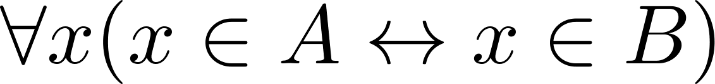
Set Equality
Definition: Two sets are equal if and only if they have the same elements.
Therefore if A and B are sets, then A and B are equal if and only if .
We write A = B if A and B are equal sets.
{1,3,5} = {3, 5, 1}
{1,5,5,5,3,3,1} = {1,3,5}

Slide 32
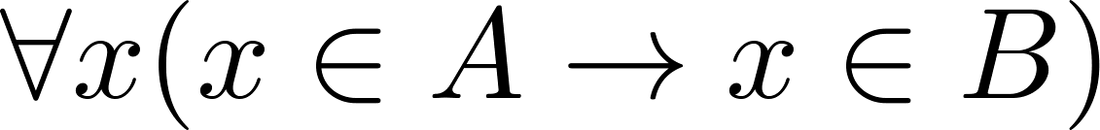
Subsets
Definition: The set A is a subset of B, if and only if every element of A is also an element of B.
The notation A ⊆ B is used to indicate that A is a subset of the set B.
A ⊆ B holds if and only if is true.
Because a ∈ ∅ is always false, ∅ ⊆ S ,for every set S.
Because a ∈ S → a ∈ S, S ⊆ S, for every set S.

